Slide 1


Smart Transit Manager
SMART TRANSIT MANAGER
SIVA BALAJI S (ES23IT101)
SASI R (ES23IT95)
PRAVEEN V (ES23IT81)
SANJAY R (ES23IT89)
VIGNESHWARAN D (ES23IT119)
SANTHOSHKUMAR V (ES23IT93)

Slide 2
Smart Transit Manager
Abstract
Our Project introduces a web-based transit management solution, It was designed to improve public bus services through real-time tracking of a bus
Route management and control panel of a admin should control the entire tracking system dynamically
By using PHP lang to achieve the AJAX method to display the informations without any delay for the efficient outcome of this project
By using the centralized database and an interactive map interface for User and control units can monitor buses

Slide 3
Smart Transit Manager
Introduction
Everyday, thousands of passengers depends on buses to reach schools, workplaces and cities but often, they face challenges like uncertain arrival times, unexpected delays, or poor communication during breakdowns or route changes
Our project , Smart Transit Manager was built to solve these problems by connecting passengers, drivers, and administrators stay connected together
Using interactive maps, live bus tracking and instant announcement makes our user to travel safer, more reliable and stress free
We also analyze passenger stats on weekdays vs. weekends to get more reliable results by comparing patterns between these days

Slide 4
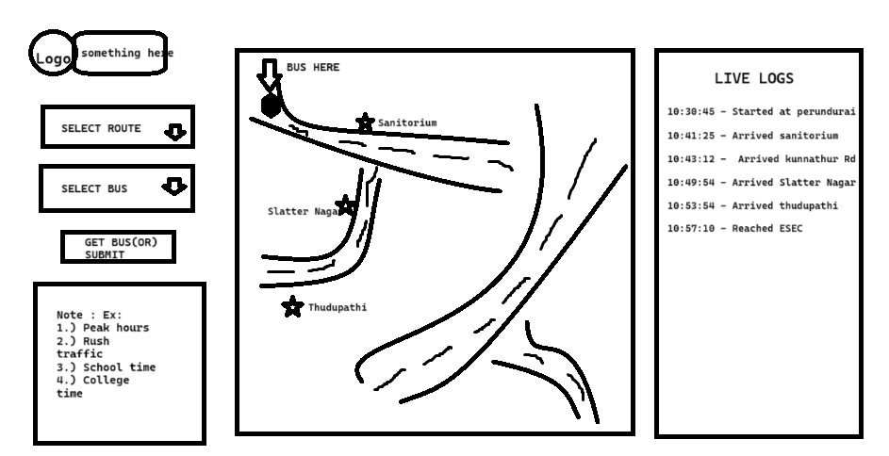
Smart Transit Manager
Rough Sketch for UI
Bus shown here
Live Logs display
Stop Names
Route & Bus
Selection
Needed
Informations
Public user interface

Slide 5
Smart Transit Manager
Existing Model
The existing model has a emerged features of tracking system ,but the problem with that is they always wanted you to login to access the features of their system
This may concern about the user data privacy and bunch amount of login tries in the same location will cause the congestion in the network and server may slowdown to displaying results

Slide 6
Smart Transit Manager
Proposed Model
We decided to keep our site always accessible and built it on the principle of Press to Track (P2T). This makes it simple and convenient for passengers to use, especially benefiting senior citizens and specially-abled individuals by allowing them to access our system with ease and comfort
We also decided to add the statistics of the bus, Like how the bus loads each and everyday especially on the weekdays and weekend days, This will helps the peoples to know about the bus on the peak days and peak hours
By using this statistics we can add Estimated Time of Arrival (ETA) to our system in Future Updates

Slide 7
Smart Transit Manager
Content to be added here
Content to be added

Slide 8
Smart Transit Manager
Content to be added here
Content to be added

Slide 9
Smart Transit Manager
Content to be added here
Thankyou!

Slide 10
Smart Transit Manager
Content to be added here
Thankyou!

Slide 11
Smart Transit Manager
Thankyou!

